Slide 1
What’s the Big Idea?

Slide 2
Mission
Mission: To develop and design biometric feedback systems in the medical device and personal health markets.
First Product: Non-invasive and self calibrating Continuous Glucose Monitoring (CGM) watch.

Slide 3
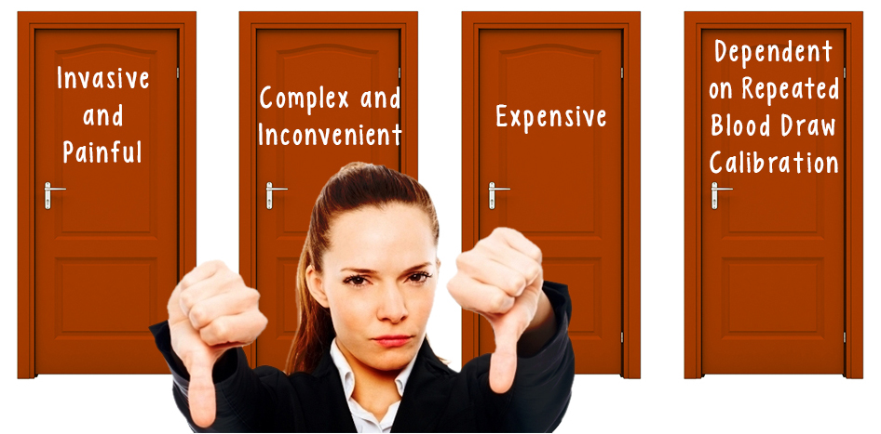
Problems with current glucose monitoring systems
The only choices currently offered are:
Copyright, 2016 Jupiter Devices. Confidential, please do not distribute or share without permission of Jupiter Devices.

Slide 4
Jupiter Watch is the solution
Noninvasive Continuous Glucose Monitoring
Noninvasive
No blood draw
No implants
Less expensive
Buy one
Use it for years
Continuous
Put Jupiter
Watch on
Auto-senses user,
Starts monitoring
Data syncs
to devices and cloud
Copyright, 2016 Jupiter Devices. Confidential, please do not distribute or share without permission of Jupiter Devices.

Slide 5
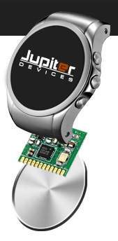
How It Works
Specific radio frequency (RF) transmitted once per minute.

Slide 6
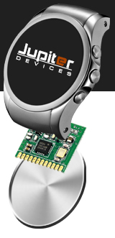
How It Works
Step I – Distance from sensor to skin surface measured.

Slide 7
How It Works
Step II – Skin hydration measured.

Slide 8
How It Works
Step III – Accurate blood glucose level determined.

Slide 9
Proof of Concept
Sensor
Signal Generator
Isotonic Saline Solution
Processor

Slide 10
Diabetes Market Size
Worldwide
Year 2015:
415 million diabetics
$673 billion spent
Year 2040 projection:
642 million diabetics
$802 billion spent
EU + N. America
Year 2015:
104.1 million diabetics
$504 billion spent
Year 2040 projection:
130.6 million diabetics
$564 billion spent
Source: International Diabetes Federation Atlas 2015
Copyright, 2016 Jupiter Devices. Confidential, please do not distribute or share without permission of Jupiter Devices.

Slide 11
Weight Loss and Athletic Markets
Can be serviced with the same Jupiter Watch as the diabetic market. No prescription required.
108 million dieters in the USA (Market Enterprises, Inc 2015)
70 million wearable fitness trackers shipped world wide in 2015, not including smart watches. (Gartner, 2015)
Copyright, 2016 Jupiter Devices. Confidential, please do not distribute or share without permission of Jupiter Devices.

Slide 12
Why Now?
Market demand is proven through sales of invasive solutions:
Dexcom: $402 million revenue in 2015
DIY CGM hack solutions are gaining traction
#WeAreNotWaiting
The Nightscout Foundation
tidepool.org
Copyright, 2016 Jupiter Devices. Confidential, please do not distribute or share without permission of Jupiter Devices.

Slide 13
Why Now?
Deal flow is recognizing the market opportunity
Dexcom: 2015 development agreement with Google.
Sano: $10.25 million seed funding for disposable patch.
Senseonics: $30.3 million for glucose monitoring implant.
GlySens: $32 million for glucose monitoring implant.
Copyright, 2016 Jupiter Devices. Confidential, please do not distribute or share without permission of Jupiter Devices.

Slide 14
Why hasn’t this been done before?
Continuous self calibration is the nut that no one else has cracked. Jupiter Devices is the next step in the evolution of glucose monitoring.
Welcome to the future.
Copyright, 2016 Jupiter Devices. Confidential, please do not distribute or share without permission of Jupiter Devices.

Slide 15
Provisional Patents
Method for detecting sensor orientation and RF coupling efficiency to test site
Method for using time based differential RF reflection patterns to determine concentration of water at test site
Method for adjusting BGL transfer function utilizing RF absorption patterns to discriminate against spurious confounding compounds
Mechanism for using the above mentioned methods to build a detailed model of the test site thereby allowing expansion upon this specific application
Copyright, 2016 Jupiter Devices. Confidential, please do not distribute or share without permission of Jupiter Devices.

Slide 16
CGM Competition Comparison
Company | Invasive or non-Invasive | Affordability | CGM Market Share | Market Cap
Jupiter | Non-Invasive | $500 One-time cost | We’re going after CGM Market | Target Exit Comparible is Dexcom
Dexcom | Invasive Implant + blood draw calibration | $5985/year *without insurance | 31.1% CGM market. | $5.8 billion Trading at 4.5x revenue **sole focus is diabetes CGM
Medtronic | Invasive Implant + blood draw calibration | $5268/year *without insurance **Only in EU | 49% total CGM market, mostly from the insulin pump side | $108 billion **10% total revenues are from diabetes division
Abbot | Invasive Implant + blood draw calibration | $2180/year *without insurance **Only in EU | 16.7% total CGM market, mostly from the insulin pump side | $64 billion **27% total revenues are from medical devices.
Copyright, 2016 Jupiter Devices. Confidential, please do not distribute or share without permission of Jupiter Devices.

Slide 17
Fitness Go To Market Strategy
Athletic training market
Weight loss market
Pre-diabetes market
Athletic retailers and trainers
Weight loss providers & retailers
Primary Care Physicians
Initial crowdfunding
Ad messaging targeted to market segments
Point of sale placement in target market outlets
Next level services through Predictive Analysis
Data access through apps
Consistent user experience designed with user input
Copyright, 2016 Jupiter Devices. Confidential, please do not distribute or share without permission of Jupiter Devices.

Slide 18
Diabetic Go To Market Strategy
Type I Diabetics: 1st target post FDA (early adopters)
Type II Diabetics: 2nd target post FDA
TARGETING
STRATEGIC
PARTNERS/
CHANNEL
Pharmacist Retail
Health Care Providers
Insurance Carriers
Diabetes community involvement & social media
Ad messaging targeted to market segments
Point of sale placement (e.g. clinics)
MARKETING
CUSTOMER RETENTION
Next level services through Predictive Analysis
Data access through apps
Consistent user experience designed with user input
Copyright, 2016 Jupiter Devices. Confidential, please do not distribute or share without permission of Jupiter Devices.

Slide 19
Founding Team
Copyright, 2016 Jupiter Devices. Confidential, please do not distribute or share without permission of Jupiter Devices.

